Slide 1




KETAN
PILLAI
Full Stack Developer

Slide 2


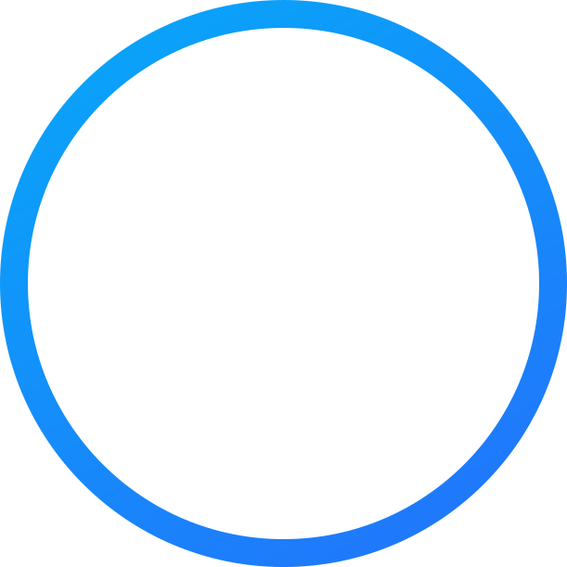
DIFFERENCE BETWEEN
Full Stack Developement
&
Mern Stack Developement

Slide 3
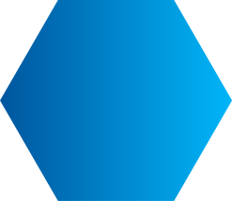
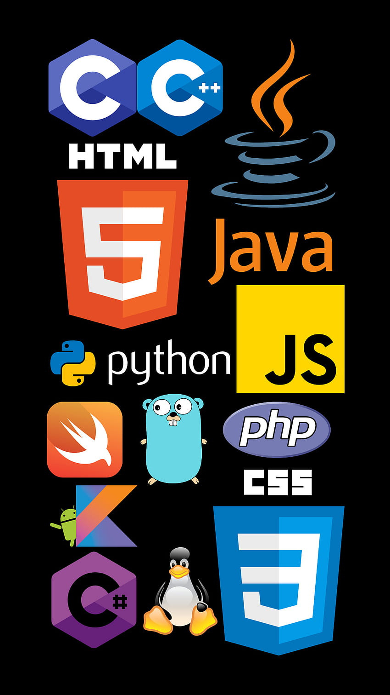


FULL STACK DEVELOPMENT
FULL STACK DEVELOPMENT INTEGRATES BOTH FRONT-END AND BACK-END TECHNOLOGIES, ENABLING COMPREHENSIVE APPLICATION DEVELOPMENT.

Slide 4
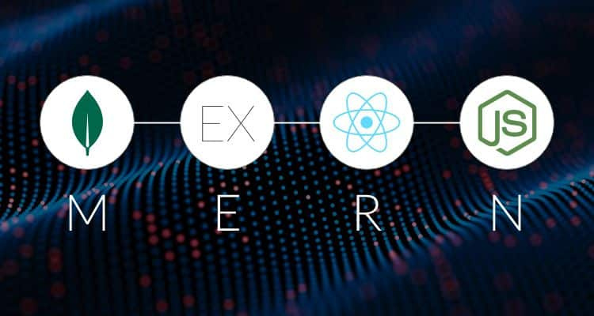
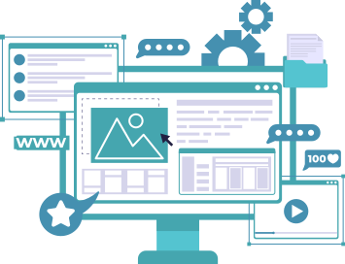
MERN STACK DEVELOPMENT
MERN STACK DEVELOPMENT INVOLVES BUILDING WEB APPLICATIONS USING FOUR MAIN TECHNOLOGIES: MONGODB, EXPRESS.JS, REACT.JS, AND NODE.JS. IT COVERS BOTH FRONT-END AND BACK-END DEVELOPMENT USING A UNIFIED STACK.

Slide 5

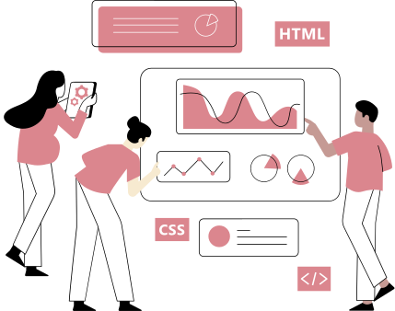

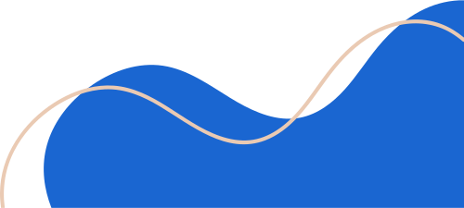
FULL STACK DEVELOPMENT
FRONT - END
The languages commonly
used in front-end
development include:
1.HTML
2.CSS
3.JavaScript
Additionally,
React
Angular
Vue.js
"Front-end developers play a crucial role in shaping how users interact with web
applications, ensuring aesthetics and
functionality align seamlessly."

Slide 6
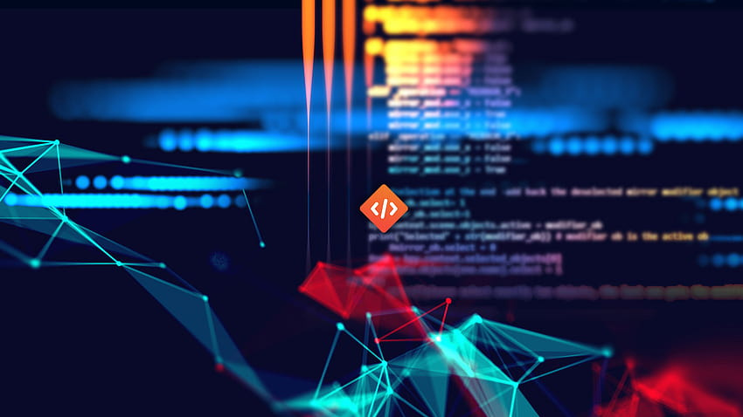
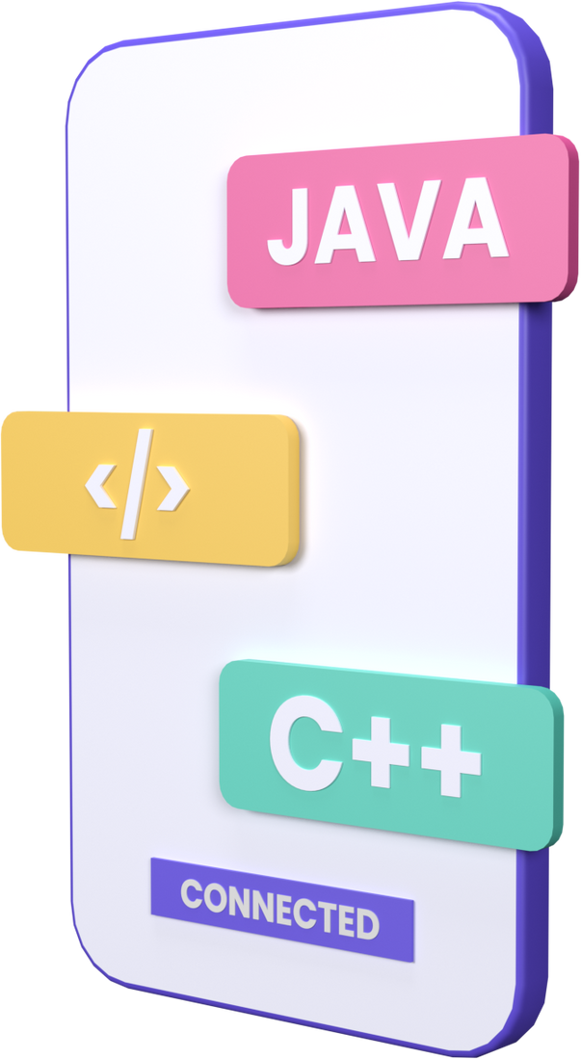

FULL STACK DEVELOPMENT
BACK - END
Programming Languages:
- JavaScript (Node.js)
- Python
- Java
- Ruby
Database Management Systems (DBMS):
- SQL (Structured Query Language)
- NoSQL Databases
Server-Side Frameworks and Platforms:
- Node.js
- Django (Python)
Backend development focuses on building
and managing the server-side components of
web applications, including data handling,
business logic, and server operations

Slide 7
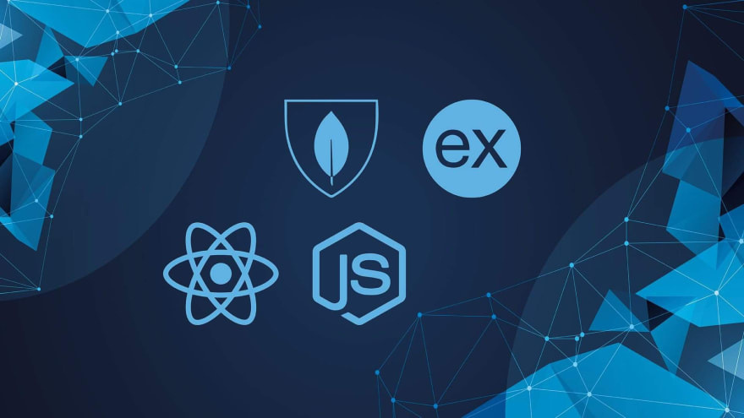
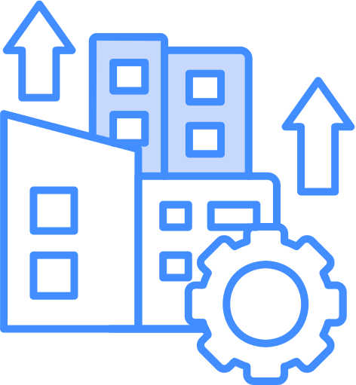


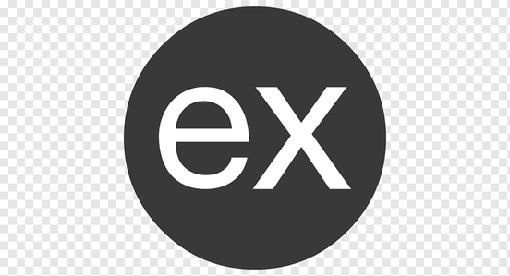

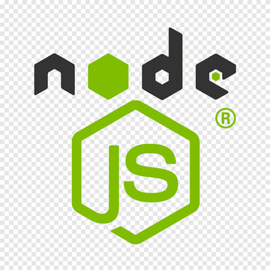



MERN STACK DEVELOPMENT
MongoDB
Express.js
React.js
Node.js

Slide 8



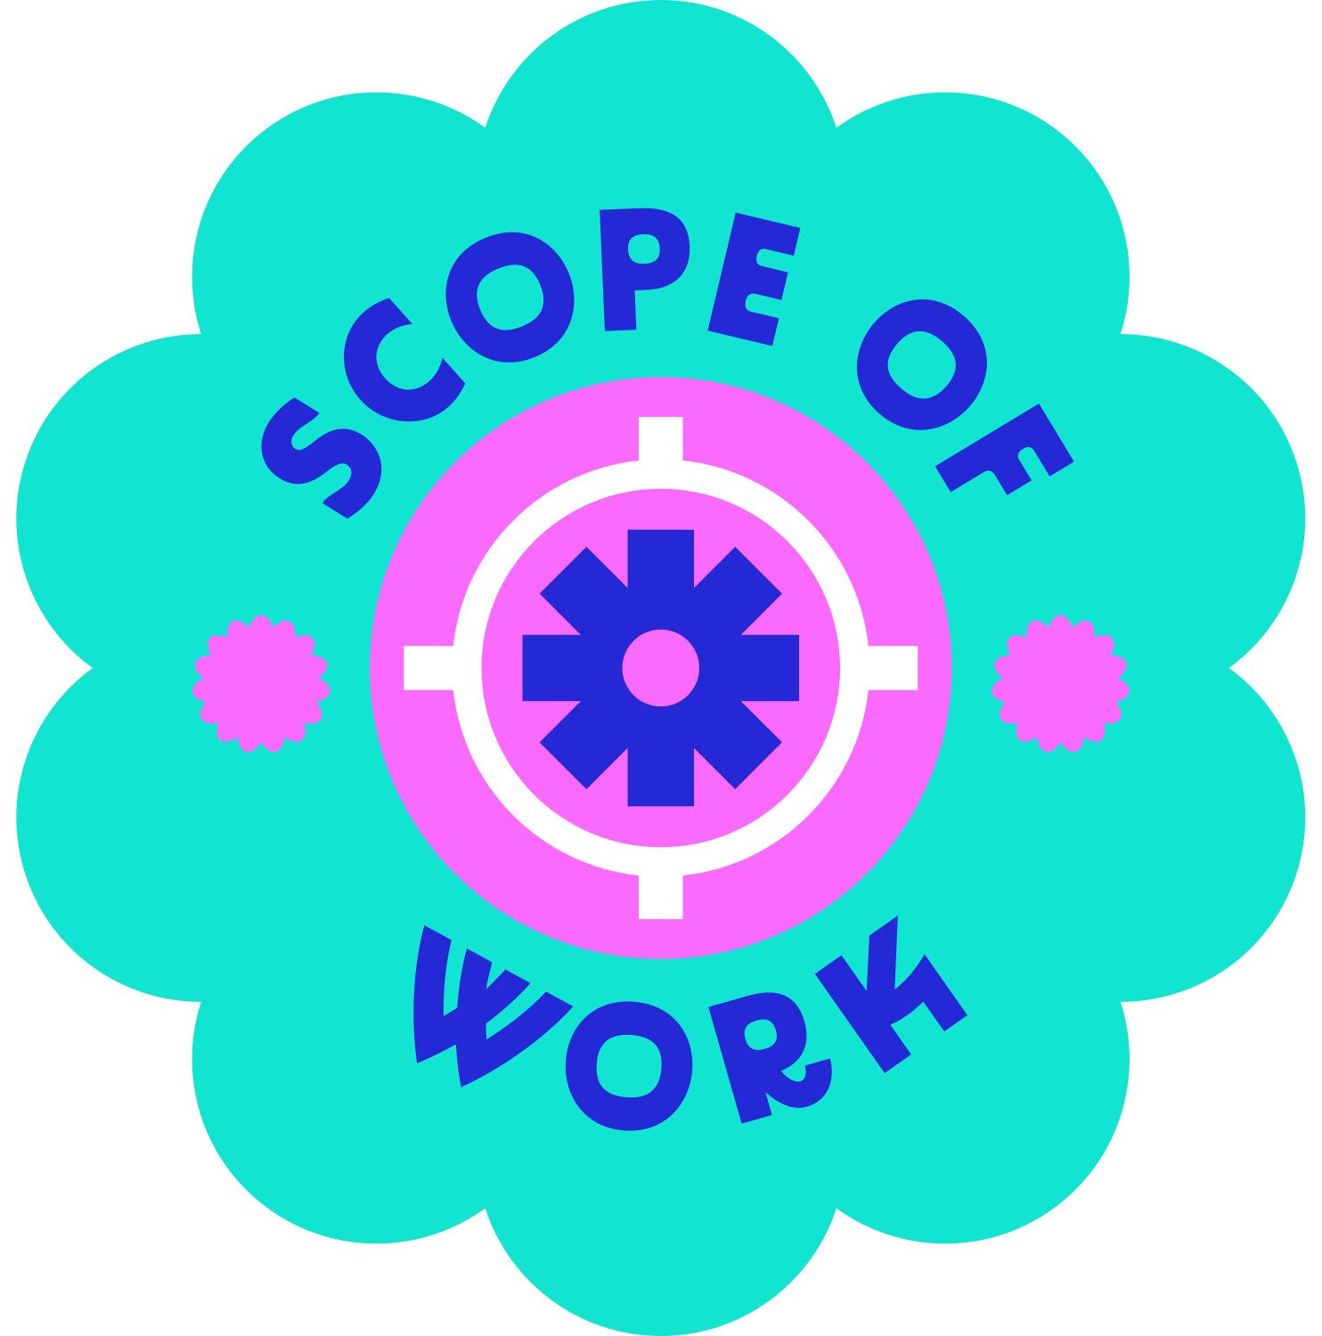



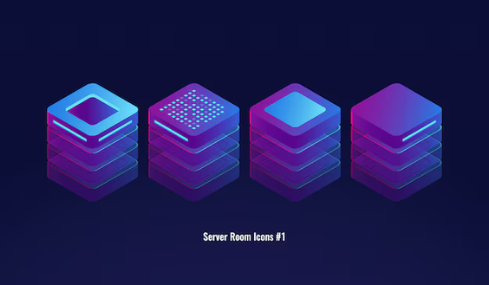



DIFFERENCE
Scope
Versatility
Learning Curve
Community and Ecosystem
Technology Stack

Slide 9




DIFFERENCE
FULL - STACK
MERN - STACK
Technologies
HTML, CSS, JavaScript, PHP, Python, Ruby, Java, .NET, etc.
MongoDB, Express.js, React, and Node.js.
Pros
Offers a well-rounded skillset that allows developers to work on any type of web application.
Provides a streamlined development process for JavaScript-based web applications.
Cons
Can be difficult to master all of the required technologies.
Not as versatile as full stack development, as it is limited to JavaScript-based applications.

Slide 10

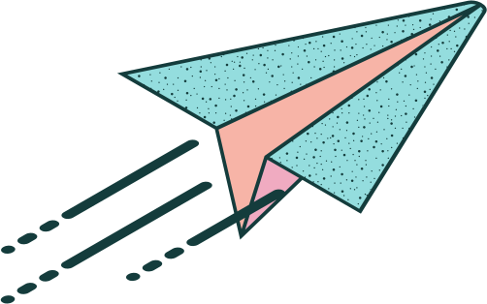
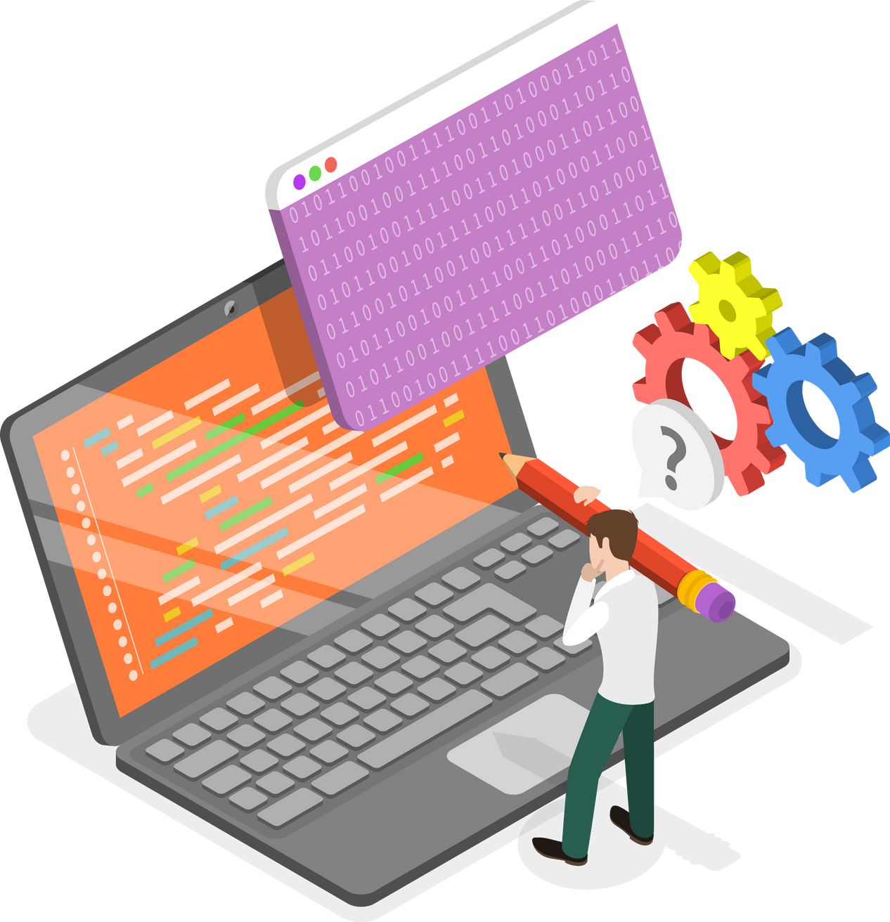
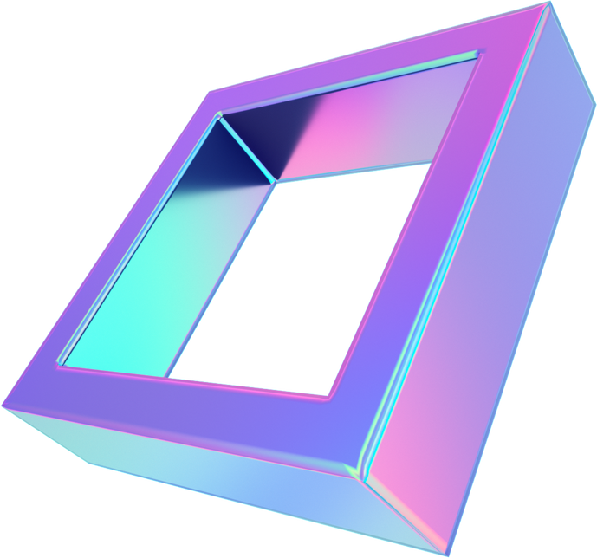

THANK YOU

